Slide 1
PROJECT REPORT
INTRODUCTION
1.1 OVERVIEW:
A subscriber to a channel on the video-sharing YouTube is a user who has chosen to receive the channel's content by clicking on that channel's "Subscribe" button, and each user's subscription feed consists of videos published by channels to which the user is subscribed. The ability to subscribe to users was introduced in October 2005. YouTube began publishing a list of its most- subscribed channels in April 2006. An early archive of the list dates to May 2006.

Slide 2
1.2 PURPOSE:
By harnessing the power of Tableau, this report not only presents the data in visually appealing manner but also provides an interactive experience for readers to explore the intricacies of World’s YouTube Subscribers Count. To extract Insights from the data and put the data in the form of Visualizations, Dashboards and Story we employed Tableau tool.

Slide 3
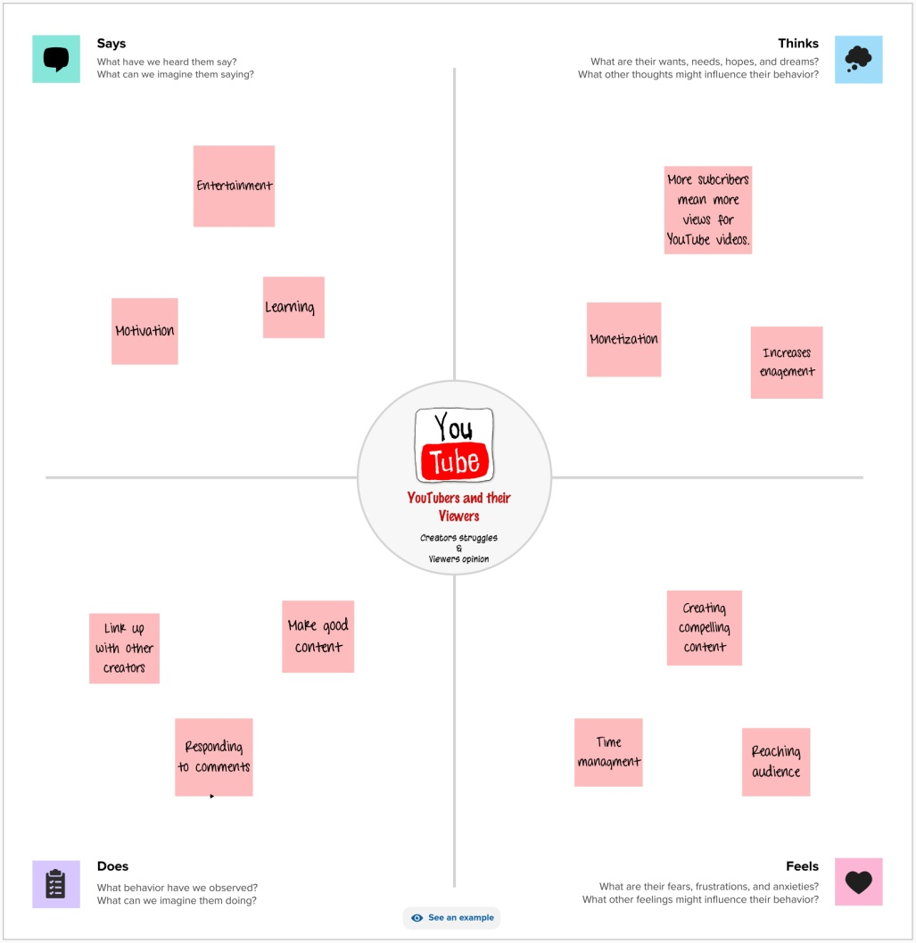
2.Problem Defining and Design thinking
2.1 EMPATHY MAP:

Slide 4
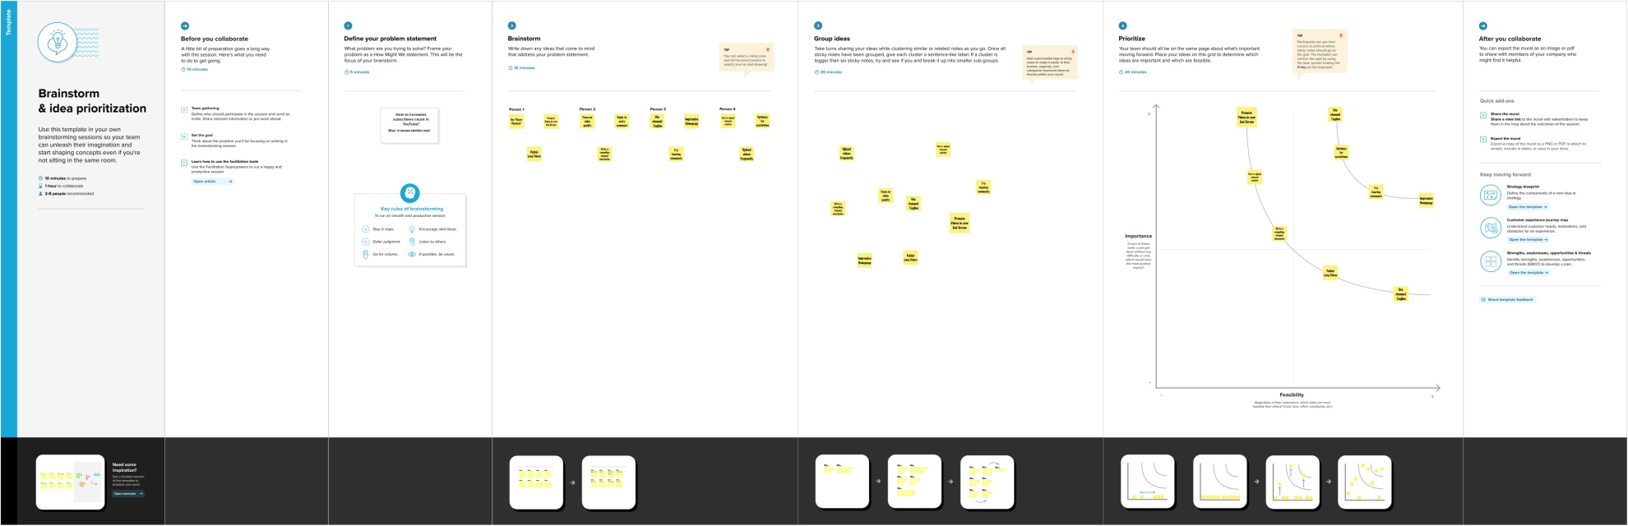
2.2 IDEATION AND BRAINSTROMING MAP

Slide 5
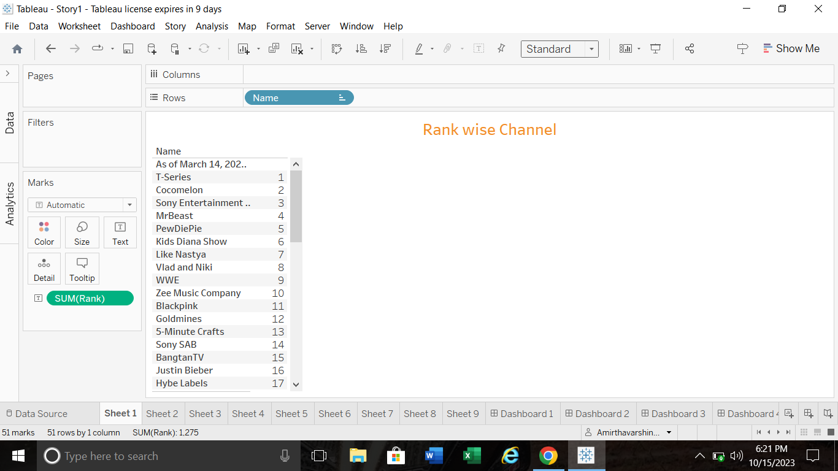
3.RESULT:

Slide 6
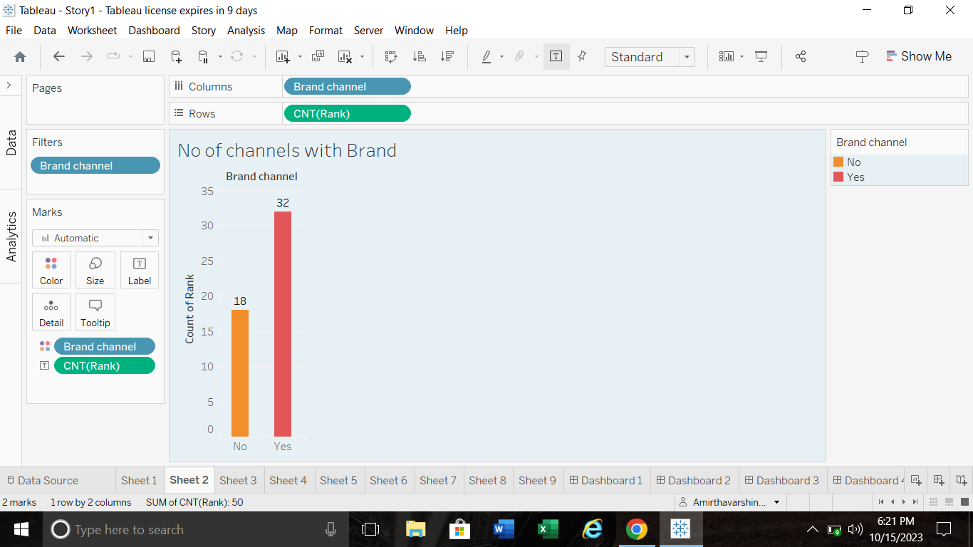

Slide 7
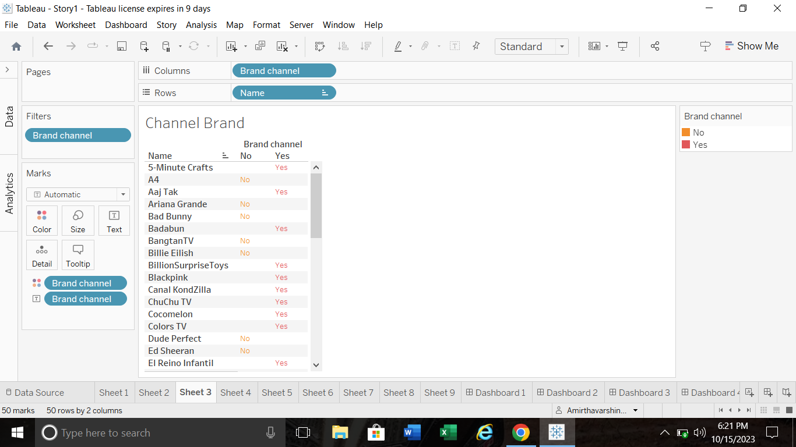

Slide 8
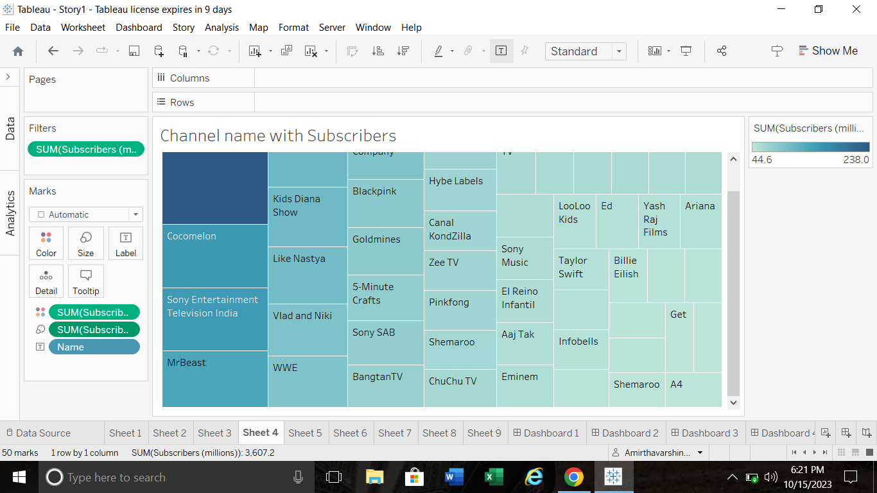

Slide 9
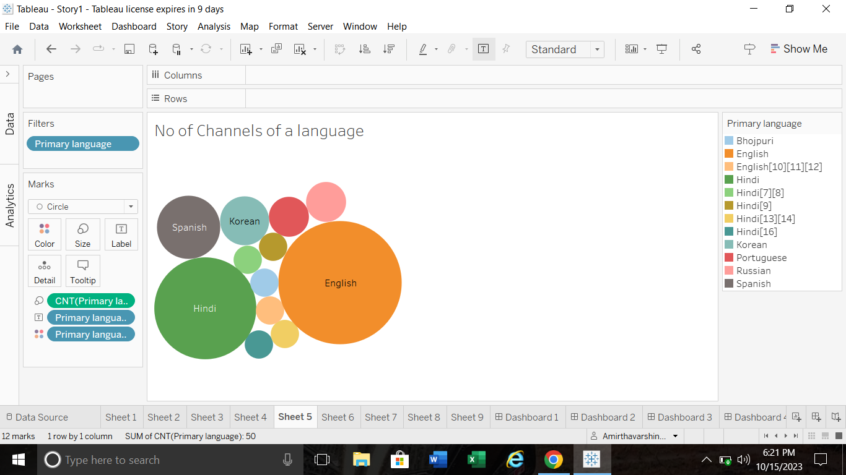

Slide 10
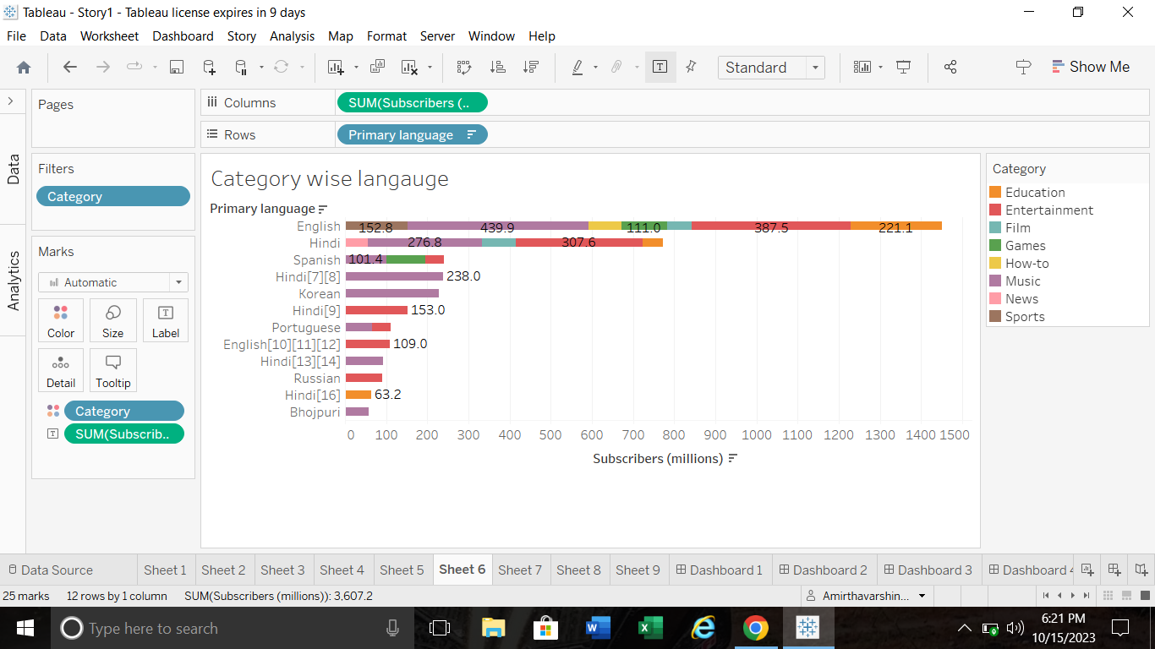

Slide 11
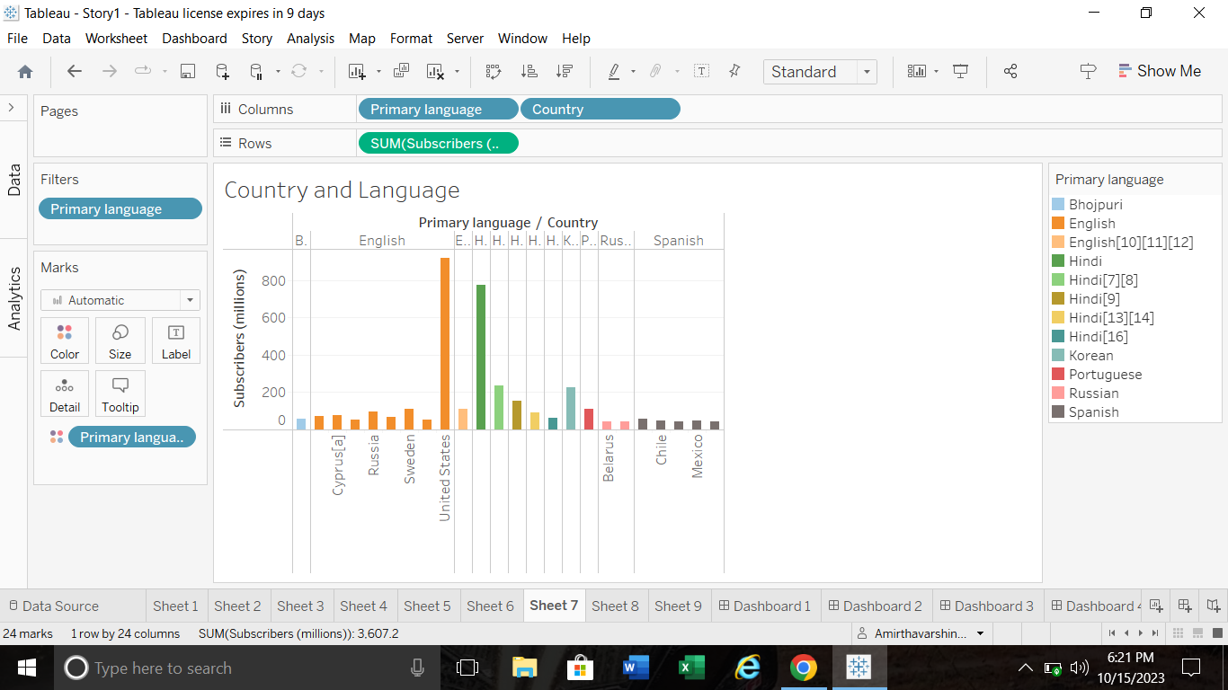

Slide 12
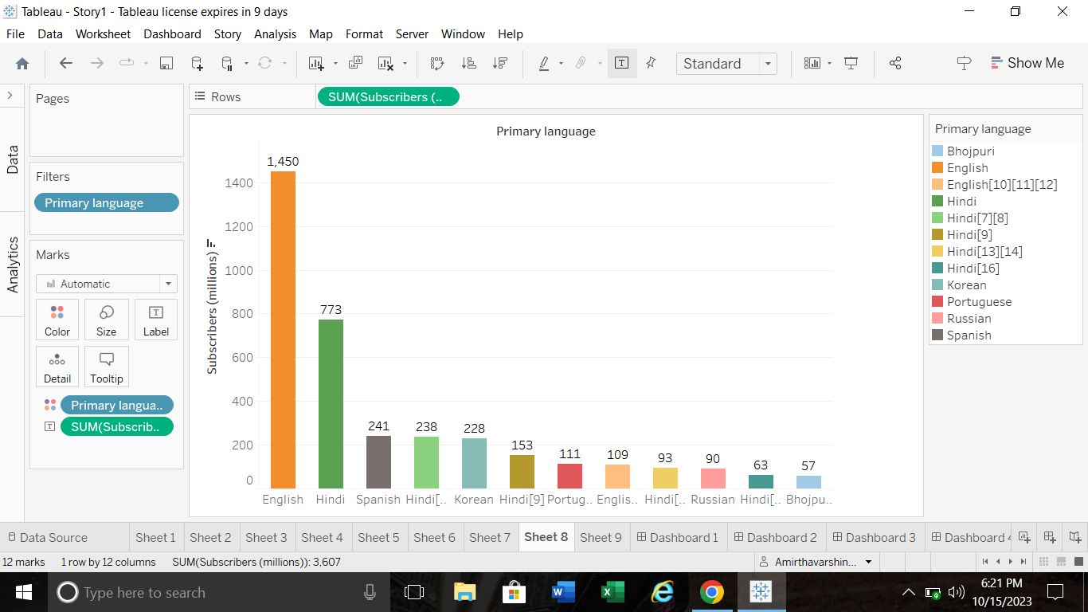

Slide 13
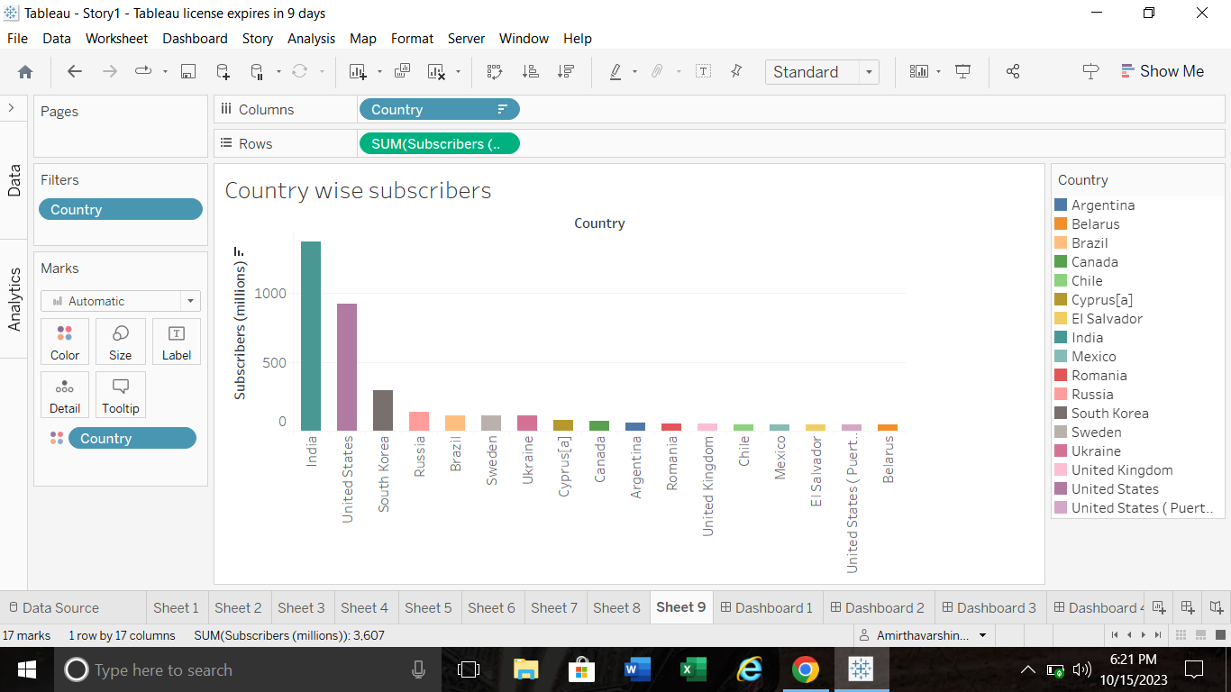

Slide 14
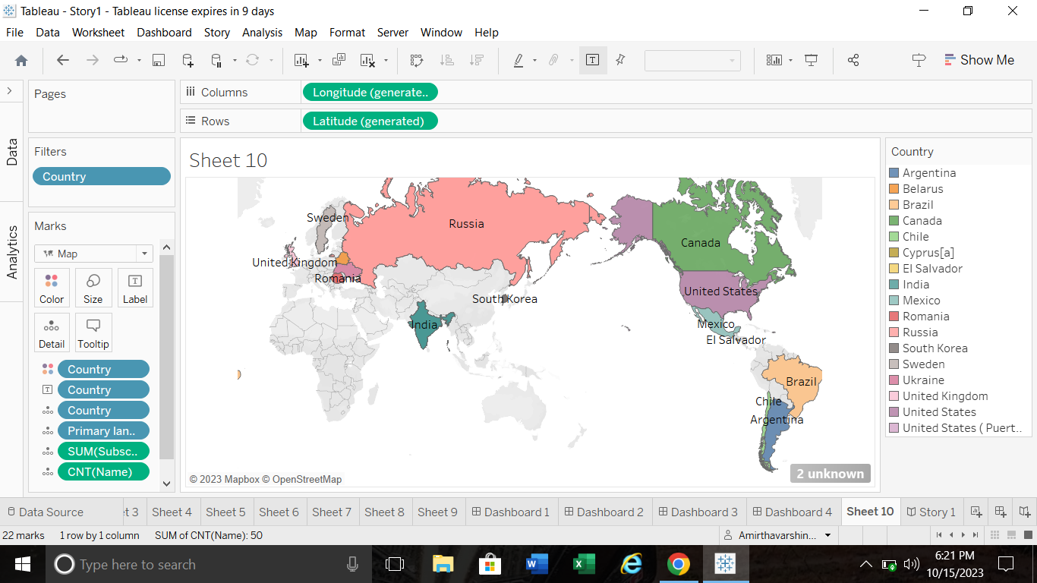

Slide 15
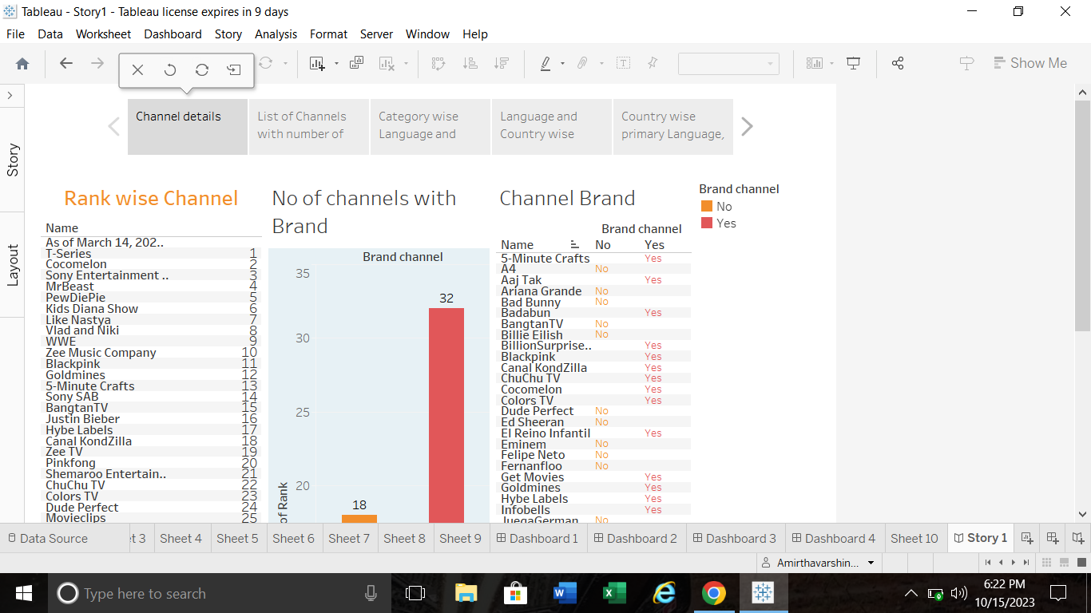

Slide 16
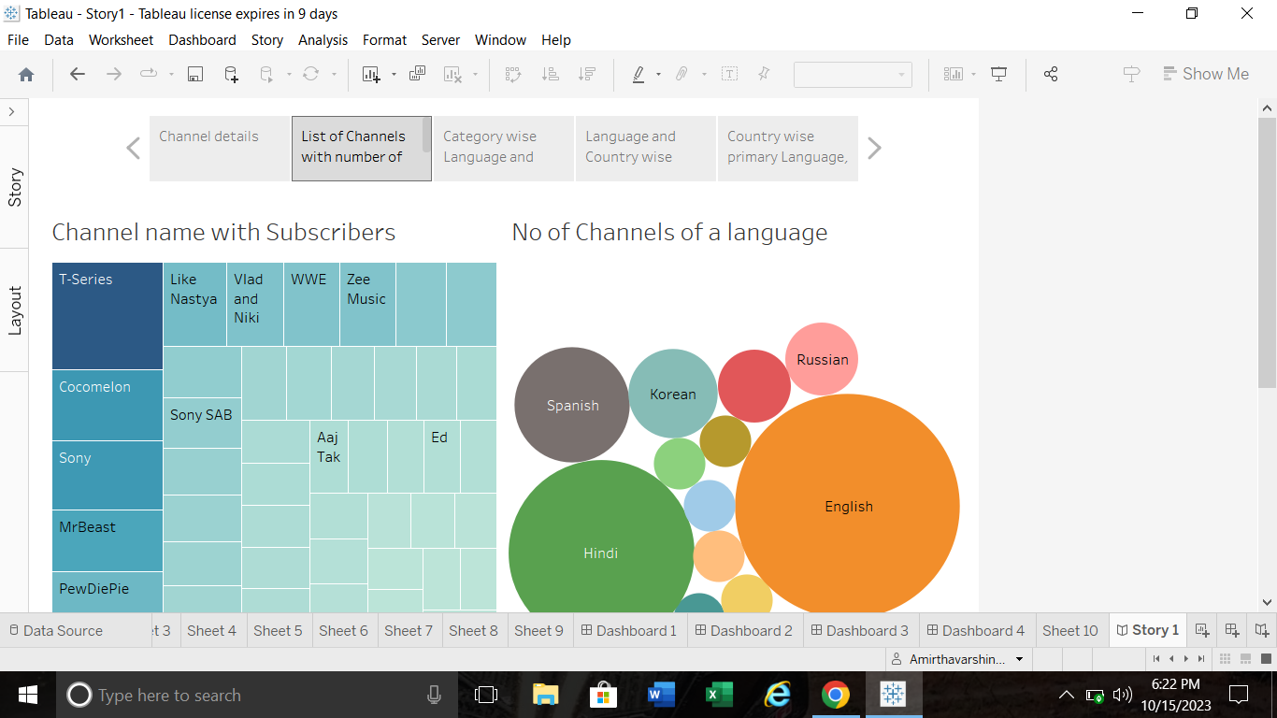

Slide 17
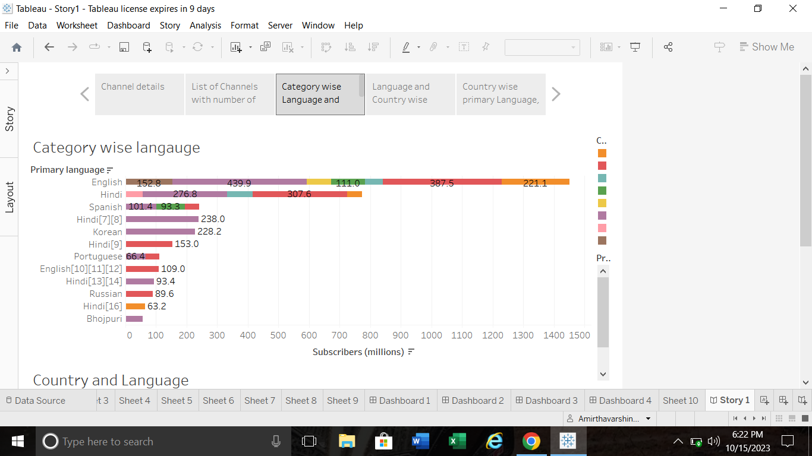

Slide 18
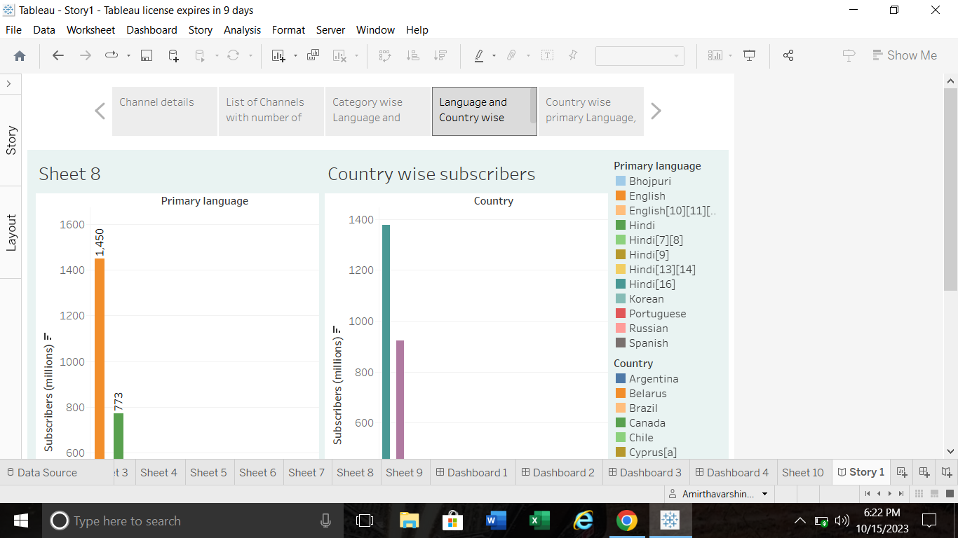

Slide 19
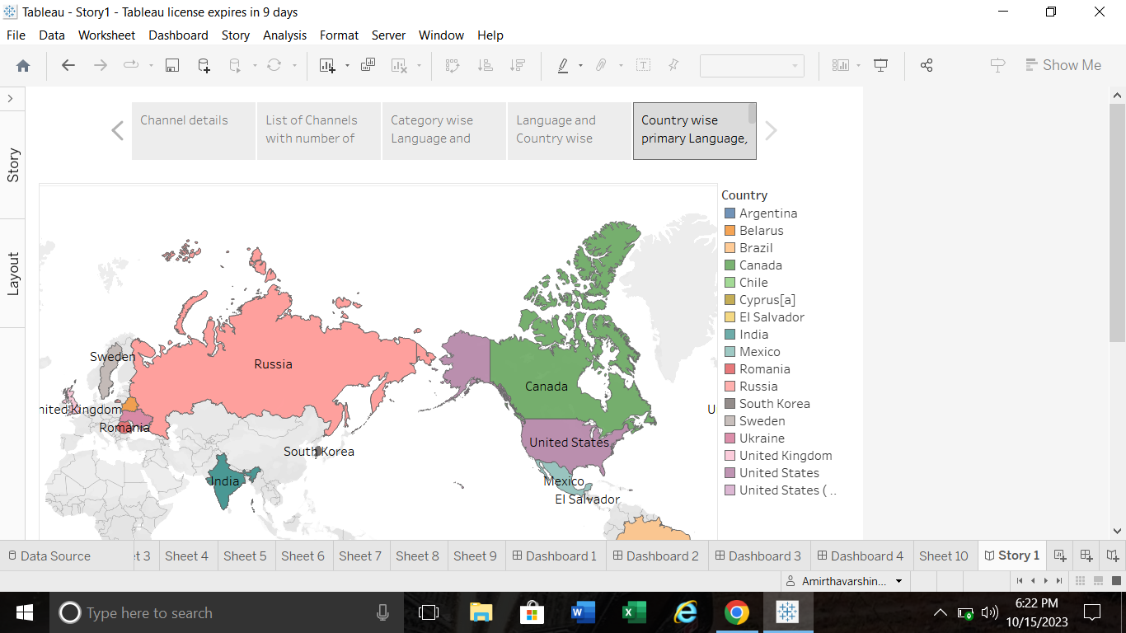

Slide 20
4.ADVANTAGES AND DISADVANTAGES:
It is useful to know about the field of agriculture.
This Project is very useful to analyise the World’s Top YouTube channels.
Time duration is the most common problem of this project.

Slide 21
5.APPLICATIONS
Tableau is an excellent tool for managing large datasets. It may be used for data collection, analysis and visualization.
The greater number of variables, the easier it is to comprehend and make predictions.

Slide 22
6.CONCLUSION:
Finally the processes which have been done by our team is published on tableau the video of our project is demonstrated. The project report is given above. We have a clear dashboards and story which are to be easily understood.

Slide 23
7.FUTURESCOPE:
This project gave us a guidance to get a job later to this field in our future in a software companies. We may be analysis in our life.

